Slide 1
EMT GRN
Gould PLoS Comp-Bio paper
Bassen

Slide 2
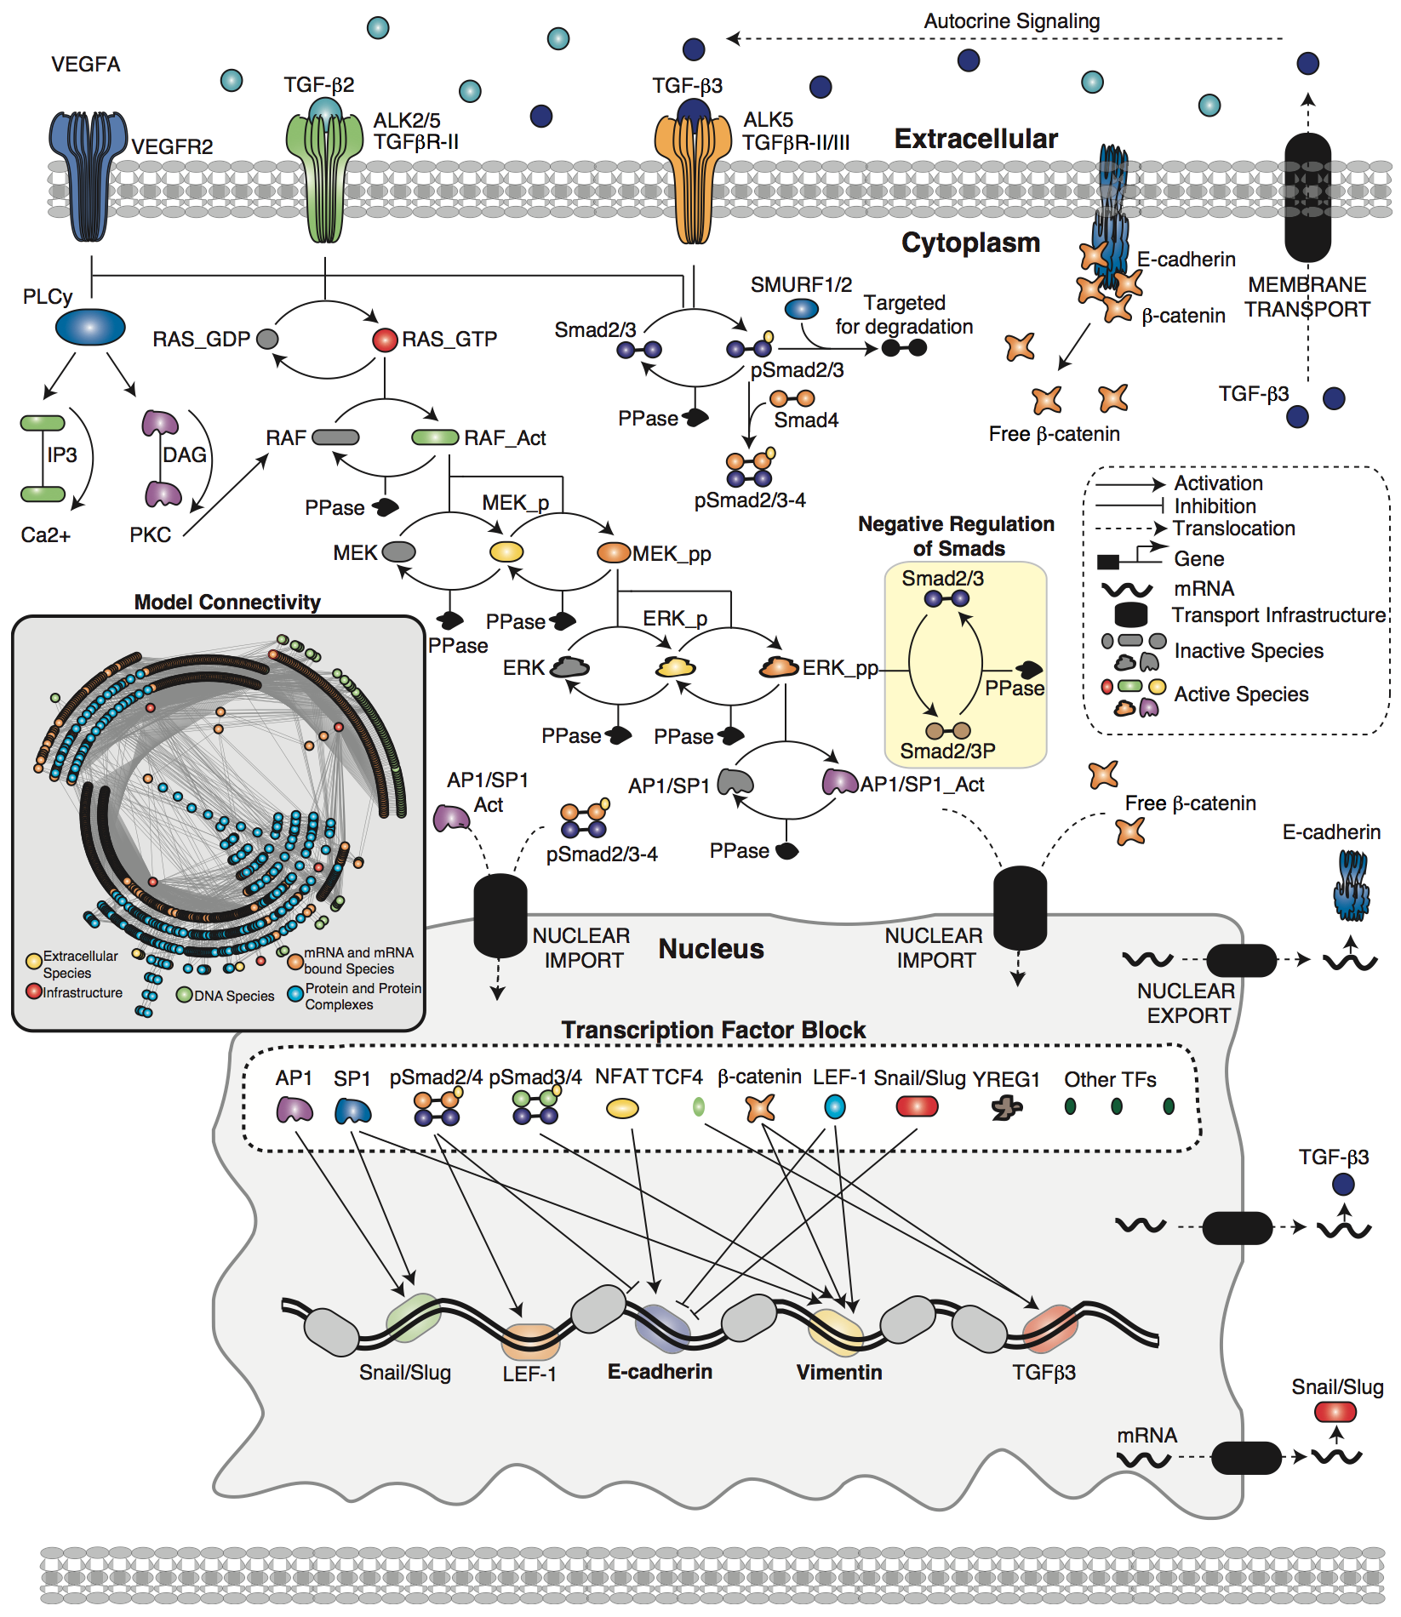
p
p
MAPK
MAPK
SMAD
p
TC4F
Active_TC4F
p
NFATC1
AP1
p
SMAD

Slide 3
Connection to NFAT

Slide 5
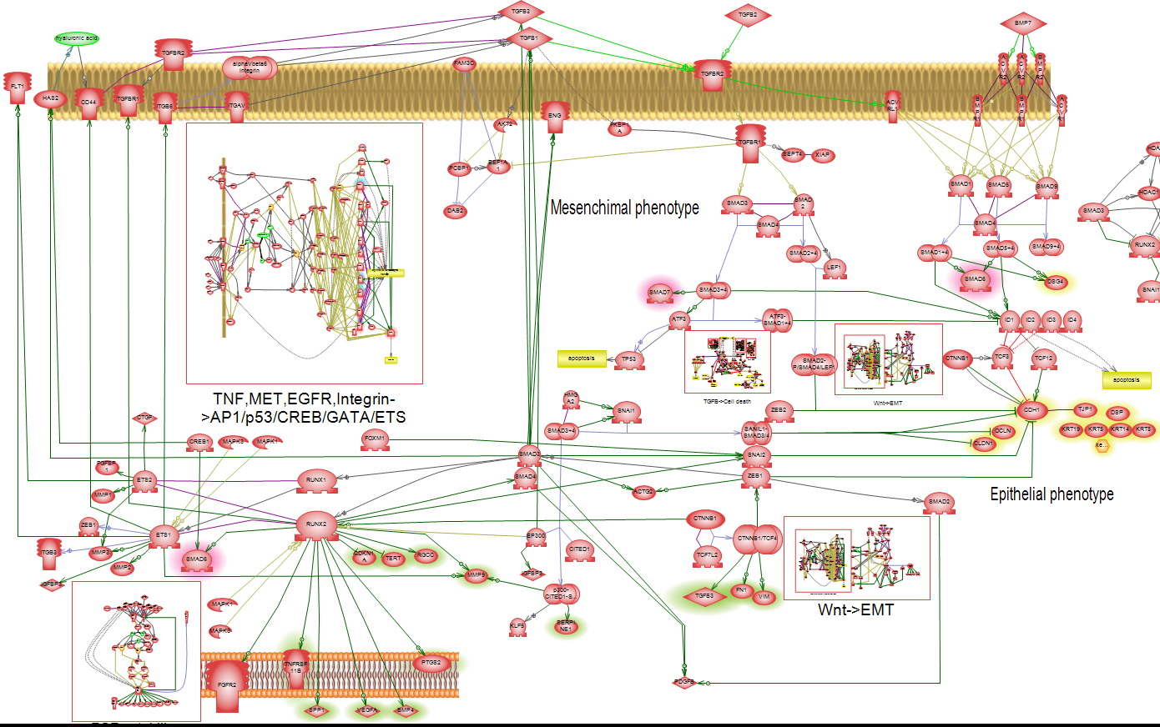
TGF-β autocrine loop sustains EMT

Slide 6
Notes:
2014 Suehiro

Slide 7
Notes:
http://www.ncbi.nlm.nih.gov/pubmed/23669445

